Slide 1
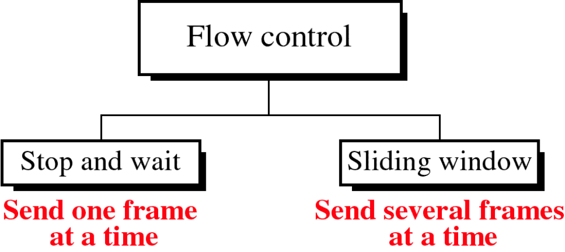

Slide 2
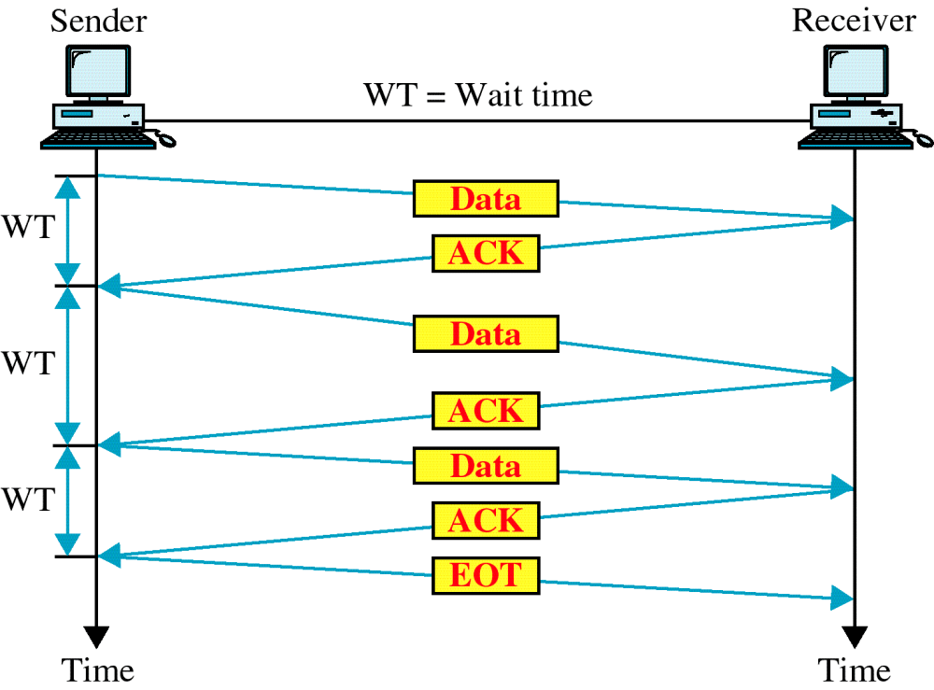
Stop and Wait

Slide 3
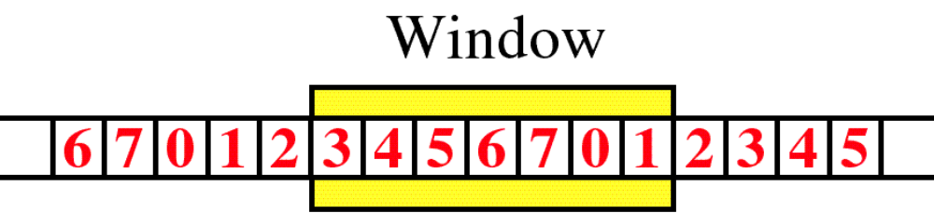
Sliding Window

Slide 4
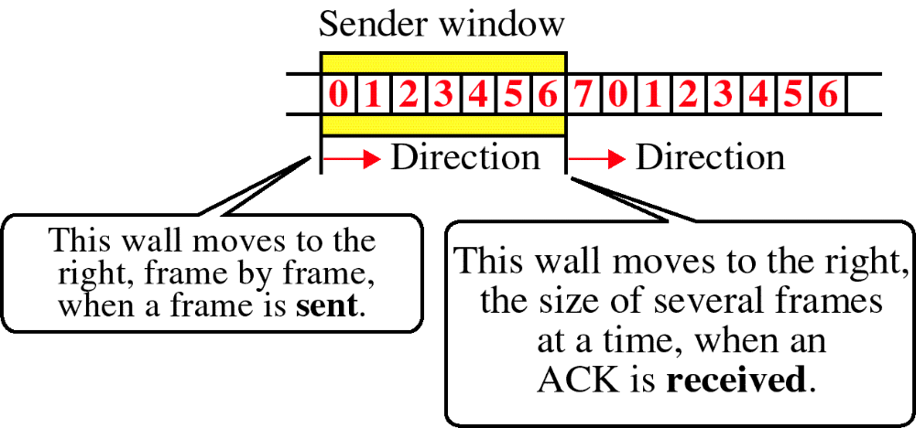
Sender Sliding Window

Slide 5
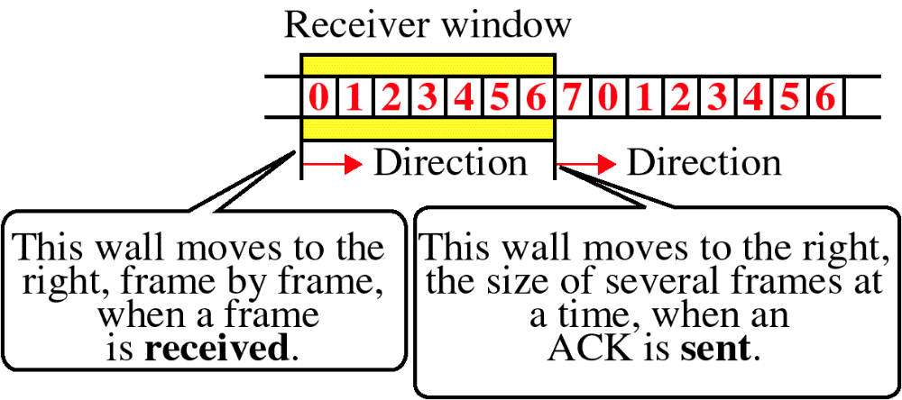
Receiver Sliding Window

Slide 6
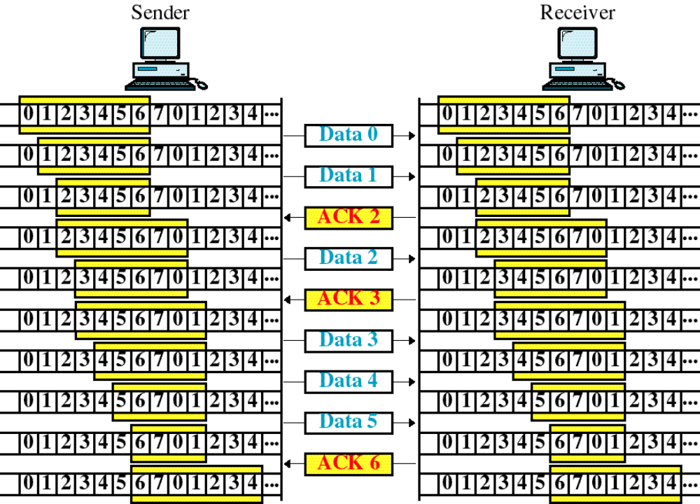
Sliding Window Example

Slide 7
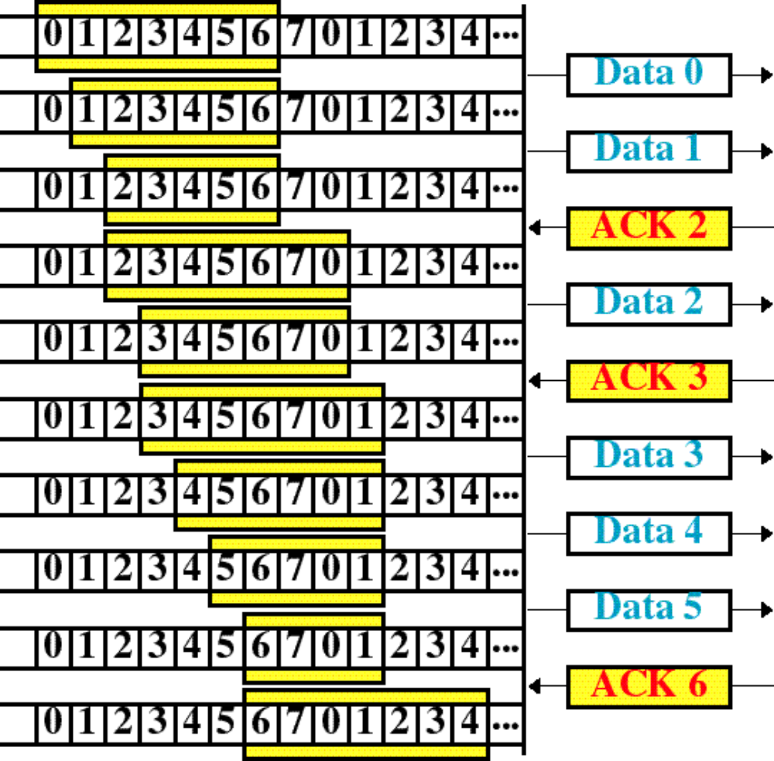
Sender

Slide 8
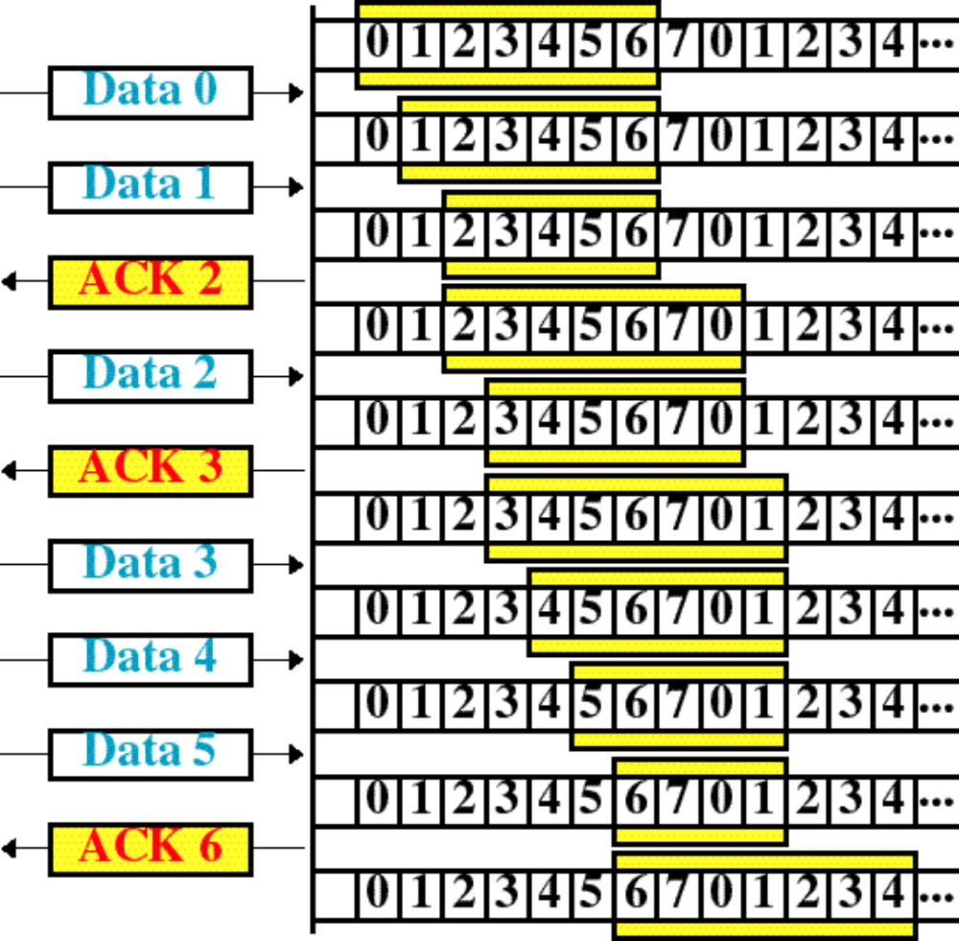
Receiver

Slide 9
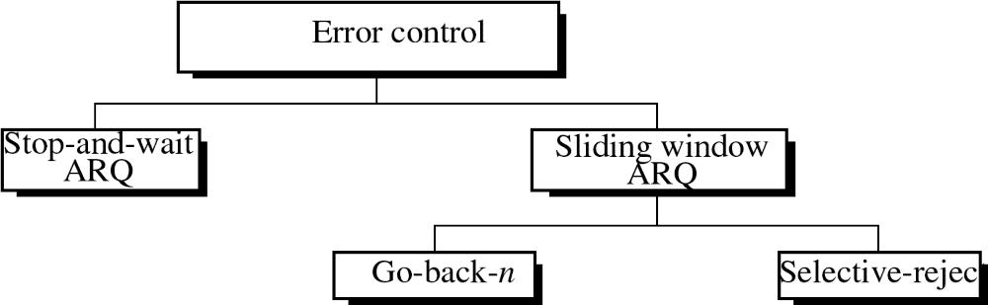

Slide 10
Stop-and-Wait ARQ
Sender keeps a copy of the last frame until it receives an ACK for that frame.
For identification purposes, both data frames and ACK frames are numbered alternatively 0 and 1.
NAK frame is returned if an error is discovered in a data frame.
Sender is equipped with a timer for retransmission if frame was not acknowledged within time out.

Slide 11
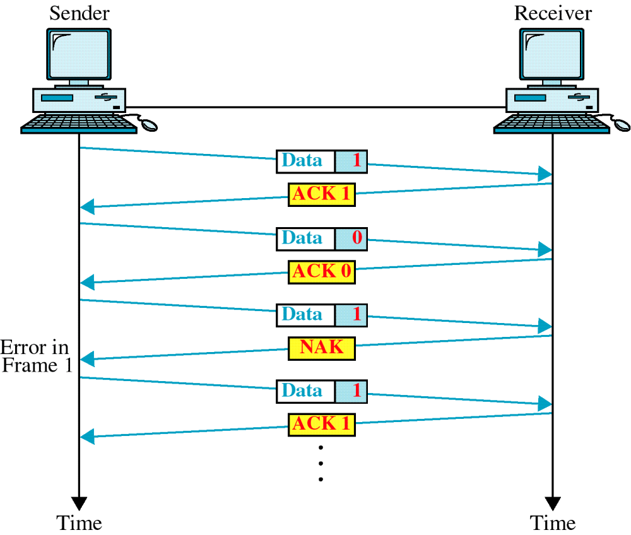
Damaged Frame

Slide 12
Lost Frame

Slide 13
Sliding Window ARQ
Sender keeps copies of all transmitted frames until they have been acknowledged.
Numbered NAK frame is returned if an error is discovered in a data frame. ACK may acknowledges frames as groups but NAK should returns individually.
Sender is equipped with a timer for retransmission if n−1 frames may be sent before an acknowledgment must be received.

Slide 14
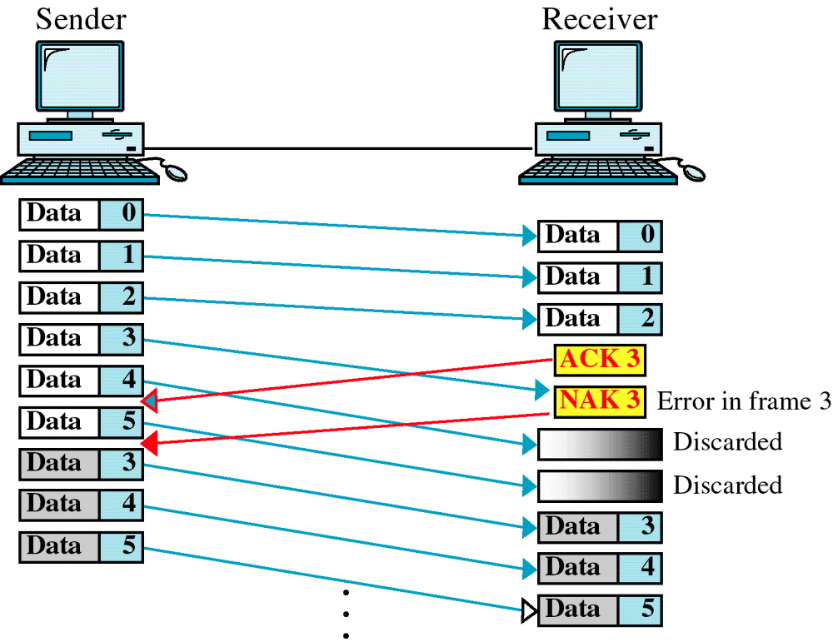
Go-back-n, damaged data frame

Slide 15
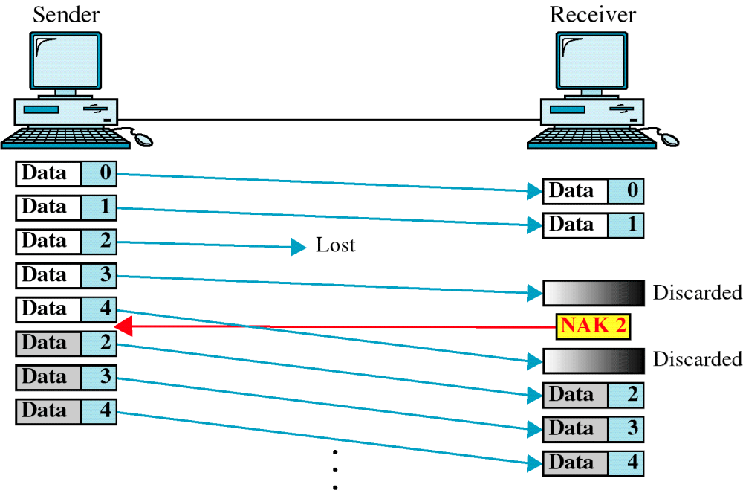
Go-back-n, lost data frame

Slide 16
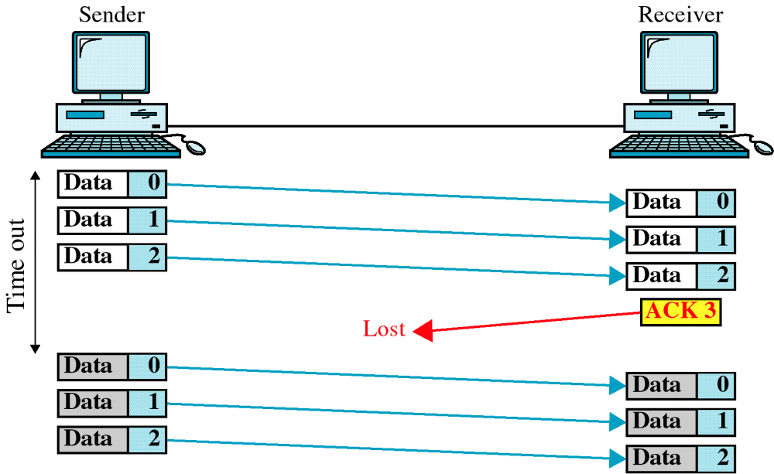
Go-back-n, lost ACK

Slide 17
Selective-Reject ARQ
Receiver must contain sorting logic to reorder frames received out of sequence.
Sender must contain a searching mechanism to find and select only the requested frame for retransmission.
ACK and NAK numbers refer to the frame received (or lost) instead of the next frame expected.
Window size is smaller than go-back-n.

Slide 18
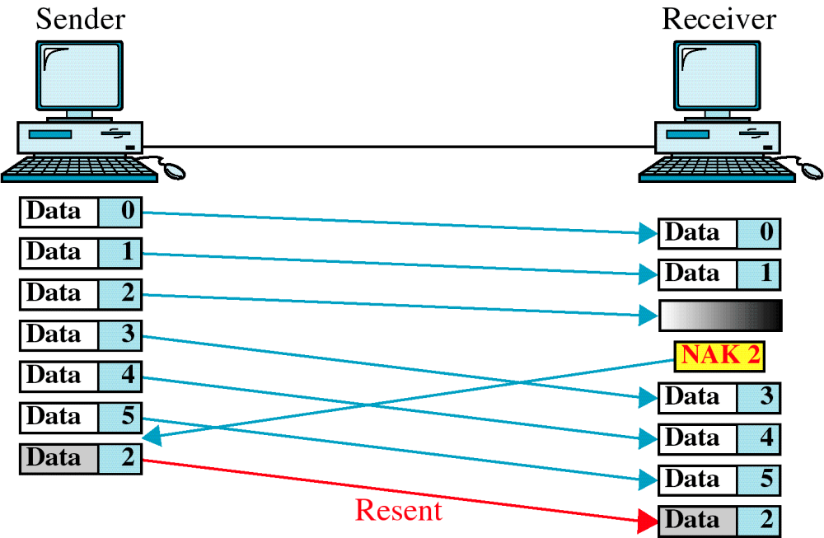
Selective Reject

